Slide 1
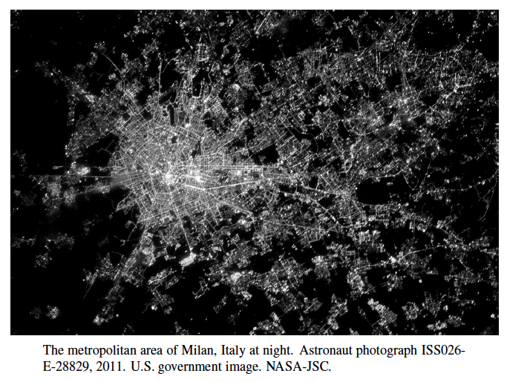
Graph Terminology and Representations
Presentation for use with the textbook, Algorithm Design and Applications, by M. T. Goodrich and R. Tamassia, Wiley, 2015

Slide 2
Graphs
A graph is a pair (V, E), where
V is a set of nodes, called vertices
E is a collection of pairs of vertices, called edges
Vertices and edges are positions and store elements
Example:
A vertex represents an airport and stores the three-letter airport code
An edge represents a flight route between two airports and stores the mileage of the route
849
PVD
1843
ORD
142
SFO
802
LGA
337
1743
1387
HNL
2555
1099
LAX
1233
DFW
1120
MIA

Slide 3
Edge Types
Directed edge
ordered pair of vertices (u,v)
first vertex u is the origin
second vertex v is the destination
e.g., a flight
Undirected edge
unordered pair of vertices (u,v)
e.g., a flight route
Directed graph
all the edges are directed
e.g., route network
Undirected graph
all the edges are undirected
e.g., flight network
flight
AA 1206
ORD
PVD
849
miles
ORD
PVD

Slide 4
Applications
Electronic circuits
Printed circuit board
Integrated circuit
Transportation networks
Highway network
Flight network
Computer networks
Local area network
Internet
Web
Databases
Entity-relationship diagram

Slide 5
Terminology
End vertices (or endpoints) of an edge
U and V are the endpoints of a
Edges incident on a vertex
a, d, and b are incident on V
Adjacent vertices
U and V are adjacent
Degree of a vertex
X has degree 5
Parallel edges
h and i are parallel edges
Self-loop
j is a self-loop
V
a
b
h
j
U
d
X
Z
c
e
i
W
g
f
Y

Slide 6
Terminology (cont.)
Path
sequence of alternating vertices and edges
begins with a vertex
ends with a vertex
each edge is preceded and followed by its endpoints
Simple path
path such that all its vertices and edges are distinct
Examples
P₁=(V,b,X,h,Z) is a simple path
P₂=(U,c,W,e,X,g,Y,f,W,d,V) is a path that is not simple
V
a
b
P₁
d
U
X
Z
P₂
h
c
e
W
g
f
Y

Slide 7
Terminology (cont.)
Cycle
circular sequence of alternating vertices and edges
each edge is preceded and followed by its endpoints
Simple cycle
cycle such that all its vertices and edges are distinct
Examples
C₁=(V,b,X,g,Y,f,W,c,U,a,↵) is a simple cycle
C₂=(U,c,W,e,X,g,Y,f,W,d,V,a,↵) is a cycle that is not simple
V
a
b
d
U
X
Z
C₂
h
e
C₁
c
W
g
f
Y

Slide 8
Properties
Theorem 13.6:
Σ_{v} deg(v) = 2m
Proof: each edge is counted twice
Theorem 13.8 (part 1):
In an undirected graph with no self-loops and no multiple edges
m ≤ n (n − 1)/2
Proof: each vertex has degree at most (n − 1)
Theorem 13.7: In directed graph
Σ_{v} Indeg(v) = Σ_{v} Outdeg(v)= m
Proof: Each edge contributes one unit to sum of indegrees.
Theorem 13.8 (part 2):
In an directed graph with no self-loops and no multiple edges
m ≤ n (n − 1)
Proof: The maximum indegree of a vertex is (n − 1). The result follows from 13.7.
Notation
n number of vertices
m number of edges
deg(v) degree of vertex v
Example
n = 4
m = 6
deg(v) = 3

Slide 9
Vertices and Edges
A graph is a collection of vertices and edges.
A Simple graph is a set of vertices and edges.
We assume our graphs are simple (no self-loop and no parallel edges) unless stated otherwise
Graphs are undirected unless stated
A Vertex can be an abstract unlabeled object or it can be labeled (e.g., with an integer number or an airport code) or it can store other objects
An Edge can likewise be an abstract unlabeled object or it can be labeled (e.g., a flight number, travel distance, cost), or it can also store other objects.

Slide 10
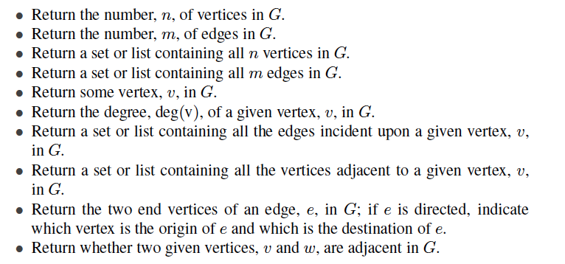
Graph Operations

Slide 11
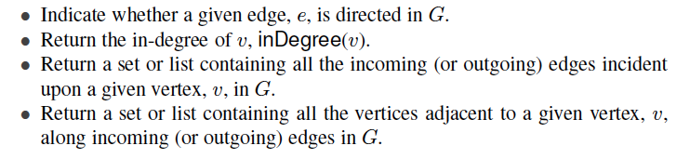
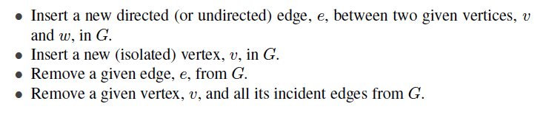
Graph Operations, Continued

Slide 12
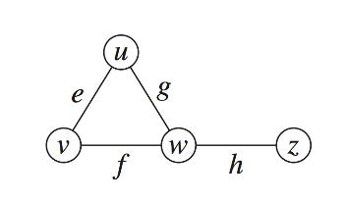
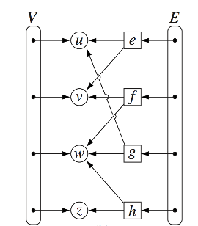
Edge List Structure
Vertex object
element
reference to position in vertex sequence
Edge object
element
origin vertex object
destination vertex object
reference to position in edge sequence
Vertex sequence
sequence of vertex objects
Edge sequence
sequence of edge objects

Slide 13
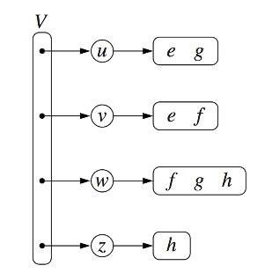
Adjacency List Structure
Incidence sequence for each vertex
sequence of references to edge objects of incident edges, such as pairs of (u, v) representing edges
Augmented edge objects
references to associated positions in incidence sequences of end vertices

Slide 14
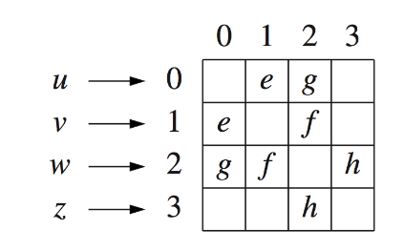
Adjacency Matrix Structure
Edge list structure
Augmented vertex objects
Integer key (index) associated with vertex
2D-array adjacency array
Reference to edge object for adjacent vertices
Null for non nonadjacent vertices
The “old fashioned” version just has 0 for no edge and 1 for edge

Slide 15
Performance (All bounds are big-oh running times, except for “Space”)
n vertices, m edges no parallel edges no self-loops | Edge List | Adjacency List | Adjacency Matrix
Space | n + m | n + m | n²
incidentEdges(v) | m | deg(v) | n
areAdjacent (v, w) | m | min(deg(v), deg(w)) | 1
insertVertex(o) | 1 | 1 | n²
insertEdge(v, w, o) | 1 | 1 | 1
removeVertex(v) | m | deg(v) | n²
removeEdge(e) | 1 | 1 | 1

Slide 16
Depth-First Search
Presentation for use with the textbook, Algorithm Design and Applications, by M. T. Goodrich and R. Tamassia, Wiley, 2015
A
B
D
E
C

Slide 17
Subgraphs
A subgraph S of a graph G is a graph such that
The vertices of S are a subset of the vertices of G
The edges of S are a subset of the edges of G
A spanning subgraph of G is a subgraph that contains all the vertices of G
Subgraph
Spanning subgraph

Slide 18
Application: Web Crawlers
A fundamental kind of algorithmic operation that we might wish to perform on a graph is traversing the edges and the vertices of that graph.
A traversal is a systematic procedure for exploring a graph by examining all of its vertices and edges.
For example, a web crawler, which is the data collecting part of a search engine, must explore a graph of hypertext documents by examining its vertices, which are the documents, and its edges, which are the hyperlinks between documents.
A traversal is efficient if it visits all the vertices and edges in linear time.

Slide 19
Connectivity
A graph is connected if there is a path between every pair of vertices
A connected component of a graph G is a maximal connected subgraph of G
Connected graph
Non connected graph with two connected components

Slide 20
Trees and Forests
A (free) tree is an undirected graph T such that
T is connected
T has no cycles
This definition of tree is different from the one of a rooted tree
A forest is an undirected graph without cycles
The connected components of a forest are trees
Tree
Forest

Slide 21
Spanning Trees and Forests
A spanning tree of a connected graph is a spanning subgraph that is a tree
A spanning tree is not unique unless the graph is a tree
Spanning trees have applications to the design of communication networks
A spanning forest of a graph is a spanning subgraph that is a forest
Graph
Spanning tree

Slide 22
Depth-First Search
Depth-first search (DFS) is a general technique for traversing a graph
A DFS traversal of a graph G
Visits all the vertices and edges of G
Determines whether G is connected
Computes the connected components of G
Computes a spanning forest of G
DFS on a graph with n vertices and m edges takes O(n + m ) time
DFS can be further extended to solve other graph problems
Find and report a path between two given vertices
Find a cycle in the graph
Depth-first search is to graphs what Euler tour is to binary trees

Slide 23
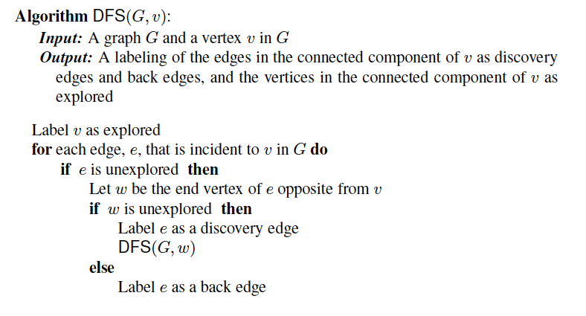
DFS Algorithm from a Vertex

Slide 24
Example
A
unexplored vertex
A
A
visited vertex
B
D
E
unexplored edge
discovery edge
C
back edge
A
A
B
D
E
B
D
E
C
C

Slide 25
Example (cont.)
A
A
B
D
E
B
D
E
C
C
A
A
B
D
E
B
D
E
C
C

Slide 26
DFS and Maze Traversal
The DFS algorithm is similar to a classic strategy for exploring a maze
We mark each intersection, corner and dead end (vertex) visited
We mark each corridor (edge ) traversed
We keep track of the path back to the entrance (start vertex) by means of a rope (recursion stack)

Slide 27
Properties of DFS
Property 1
DFS(G, v) visits all the vertices and edges in the connected component of v
Property 2
The discovery edges labeled by DFS(G, v) form a spanning tree of the connected component of v
A
B
D
E
C

Slide 28
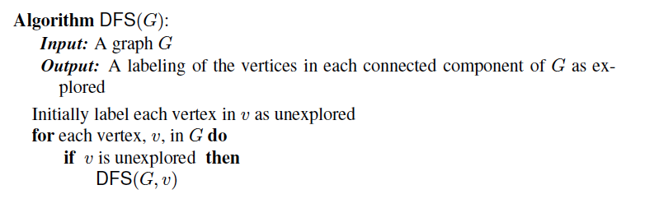
The General DFS Algorithm
Perform a DFS from each unexplored vertex in a connected component:

Slide 29
Analysis of DFS
Setting/getting a vertex/edge label takes O(1) time
Each vertex is labeled twice
once as UNEXPLORED
once as VISITED
Each edge is labeled twice
once as UNEXPLORED
once as DISCOVERY or BACK
Method incidentEdges is called once for each vertex
DFS runs in O(n + m) time provided the graph is represented by the adjacency list structure
Recall that Σ_{v} deg(v) = 2m

Slide 30
Path Finding (not in book)
We can specialize the DFS algorithm to find a path between two given vertices u and z using the template method pattern
We call DFS(G, u) with u as the start vertex
We use a stack S to keep track of the path between the start vertex and the current vertex
As soon as destination vertex z is encountered, we return the path as the contents of the stack
Algorithm pathDFS(G, v, z)
setLabel(v, VISITED)
S.push(v)
if v = z
return S.elements()
for all e ∈ G.incidentEdges(v)
if getLabel(e) = UNEXPLORED
w ← opposite(v,e)
if getLabel(w) = UNEXPLORED
setLabel(e, DISCOVERY)
S.push(e)
pathDFS(G, w, z)
S.pop(e)
else
setLabel(e, BACK)
S.pop(v)

Slide 31
Cycle Finding (not in book)
We can specialize the DFS algorithm to find a simple cycle using the template method pattern
We use a stack S to keep track of the path between the start vertex and the current vertex
As soon as a back edge (v, w) is encountered, we return the cycle as the portion of the stack from the top to vertex w
Algorithm cycleDFS(G, v, z)
setLabel(v, VISITED)
S.push(v)
for all e ∈ G.incidentEdges(v)
if getLabel(e) = UNEXPLORED
w ← opposite(v,e)
S.push(e)
if getLabel(w) = UNEXPLORED
setLabel(e, DISCOVERY)
pathDFS(G, w, z)
S.pop(e)
else
T ← new empty stack
repeat
o ← S.pop()
T.push(o)
until o = w
return T.elements()
S.pop(v)

Slide 32
Breadth-First Search
Presentation for use with the textbook, Algorithm Design and Applications, by M. T. Goodrich and R. Tamassia, Wiley, 2015
L₀
A
L₁
B
C
D
L₂
E
F

Slide 33
Breadth-First Search
Breadth-first search (BFS) is a general technique for traversing a graph
A BFS traversal of a graph G
Visits all the vertices and edges of G
Determines whether G is connected
Computes the connected components of G
Computes a spanning forest of G
BFS on a graph with n vertices and m edges takes O(n + m ) time
BFS can be further extended to solve other graph problems:
Find and report a path with the minimum number of edges between two given vertices
Find a simple cycle, if there is one

Slide 34
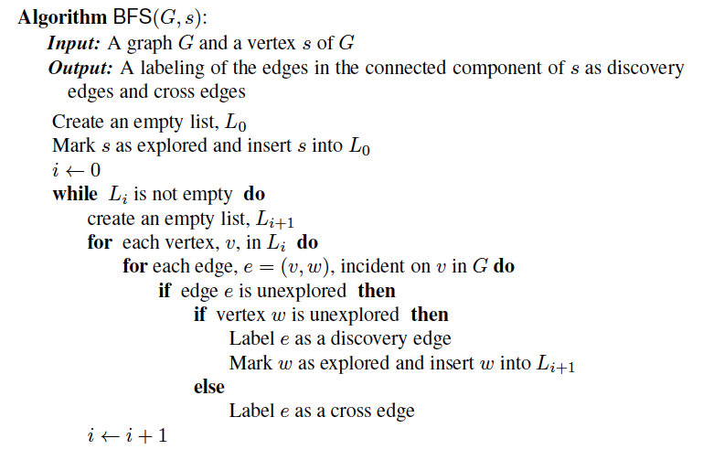
BFS Algorithm
The algorithm uses “levels” L_{i} and a mechanism for setting and getting “labels” of vertices and edges.

Slide 35
Example
L₀
unexplored vertex
A
A
A
visited vertex
L₁
B
C
D
unexplored edge
discovery edge
E
F
cross edge
L₀
L₀
A
A
L₁
L₁
B
C
D
B
C
D
E
F
E
F

Slide 36
Example (cont.)
L₀
L₀
A
A
L₁
L₁
B
C
D
B
C
D
L₂
E
F
E
F
L₀
L₀
A
A
L₁
L₁
B
C
D
B
C
D
L₂
L₂
E
F
E
F

Slide 37
Example (cont.)
L₀
L₀
A
A
L₁
L₁
B
C
D
B
C
D
L₂
L₂
E
F
E
F
L₀
A
L₁
B
C
D
L₂
E
F

Slide 38
Properties
Notation
G_{s}: connected component of s
Property 1
BFS(G, s) visits all the vertices and edges of G_{s}
Property 2
The discovery edges labeled by BFS(G, s) form a spanning tree T_{s} of G_{s}
Property 3
For each vertex v in L_{i}
The path of T_{s} from s to v has i edges
Every path from s to v in G_{s} has at least i edges
A
B
C
D
E
F
L₀
A
L₁
B
C
D
L₂
E
F

Slide 39
Analysis
Setting/getting a vertex/edge label takes O(1) time
Each vertex is labeled twice
once as UNEXPLORED
once as VISITED
Each edge is labeled twice
once as UNEXPLORED
once as DISCOVERY or CROSS
Each vertex is inserted once into a sequence L_{i}
Method incidentEdges is called once for each vertex
BFS runs in O(n + m) time provided the graph is represented by the adjacency list structure
Recall that Σ_{v} deg(v) = 2m

Slide 40
Applications
We can use the BFS traversal algorithm, for a graph G, to solve the following problems in O(n + m) time
Compute the connected components of G
Compute a spanning forest of G
Find a simple cycle in G, or report that G is a forest
Given two vertices of G, find a path in G between them with the minimum number of edges, or report that no such path exists

Slide 41
DFS vs. BFS
Applications | DFS | BFS
Spanning forest, connected components, paths, cycles | √ | √
Shortest paths |  | √
Biconnected components | √
L₀
A
A
L₁
B
C
D
B
C
D
L₂
E
F
E
F
DFS
BFS

Slide 42
DFS vs. BFS (cont.)
Back edge (v,w)
w is an ancestor of v in the tree of discovery edges
Cross edge (v,w)
w is in the same level as v or in the next level
L₀
A
A
L₁
B
C
D
B
C
D
L₂
E
F
E
F
DFS
BFS

Slide 43
Directed Graphs
Presentation for use with the textbook, Algorithm Design and Applications, by M. T. Goodrich and R. Tamassia, Wiley, 2015
BOS
ORD
JFK
SFO
DFW
LAX
MIA

Slide 44
Digraphs
A digraph is a graph whose edges are all directed
Short for “directed graph”
Applications
one-way streets
flights
task scheduling
E
D
C
B
A

Slide 45
Digraph Properties
E
D
C
A graph G=(V,E) such that
Each edge goes in one direction:
Edge (a,b) goes from a to b, but not b to a
If G is simple, m < n⋅(n − 1)
If we keep in-edges and out-edges in separate adjacency lists, we can perform listing of incoming edges and outgoing edges in time proportional to their size.
B
A

Slide 46
Digraph Application
Scheduling: edge (a,b) means task a must be completed before b can be started
cs21
cs22
cs46
cs51
cs53
cs52
cs161
cs131
cs141
cs121
cs171
The good life
cs151

Slide 47
Directed DFS
We can specialize the traversal algorithms (DFS and BFS) to digraphs by traversing edges only along their direction
In the directed DFS algorithm, we have four types of edges
discovery edges
back edges (to ancestor)
forward edges (to descendant)
cross edges (to neither ancestor, nor descendant)
A directed DFS starting at a vertex s determines the vertices reachable from s
E
D
C
B
A

Slide 48
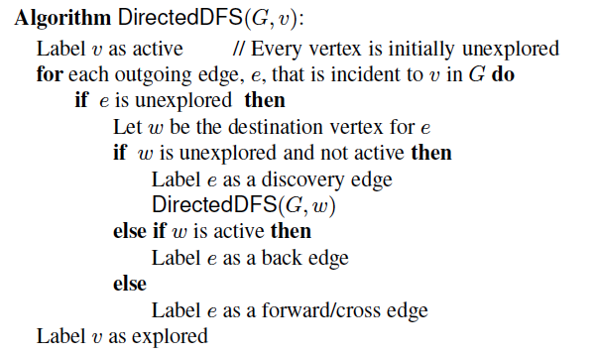
The Directed DFS Algorithm

Slide 49
Reachability
DFS tree rooted at v: vertices reachable from v via directed paths
E
D
E
D
C
A
C
F
E
D
A
B
C
F
A
B

Slide 50
Strong Connectivity
Each vertex can reach all other vertices
a
g
c
d
e
b
f

Slide 51
Testing for Strong Connectivity Algorithm
Note that G is strongly connected if each DFS visits all vertices of G. But this would take O(n(n+m))
But we can test using only two DFSs:
Pick a vertex v in G
Perform a DFS from v in G
If there’s a w not visited, print “no”
This to show s reaches every vertex
Let G’ be G with edges reversed
Perform a DFS from v in G’
If there’s a w not visited, print “no”
Else, print “yes”
This to show every vertex reaches s
Running time: O(n+m)
G:
a
c
g
d
e
f
b
a
G’:
c
g
d
e
f
b

Slide 52
Strongly Connected Components
Subgraphs such that each vertex can reach all other vertices in the subgraph
Can also be done in O(n(n+m)) time using DFS, which is inefficient. Alternative is Transitive Closure.
a
g
{ a , c , g }
c
d
e
{ f , d , e , b }
f
b

Slide 53
Transitive Closure
Given a digraph G, the transitive closure of G is the digraph G* such that
G* has the same vertices as G
if G has a directed path from u to v (u ≠ v), G* has a directed edge from u to v
The transitive closure provides reachability information about a digraph
D
E
B
G
C
A
D
E
B
C
A
G*

Slide 54
Computing the Transitive Closure
If there's a way to get from A to B and from B to C, then there's a way to get from A to C.
We can perform DFS starting at each vertex
O(n(n+m))
Alternatively ... Use dynamic programming: The Floyd-Warshall Algorithm

Slide 55
Floyd-Warshall Transitive Closure
Idea #1: Number the vertices 1, 2, …, n.
Idea #2: Consider paths that use only vertices numbered 1, 2, …, k, as intermediate vertices:
Uses only vertices numbered 1,…,k
(add this edge if it’s not already in)
i
j
Uses only vertices
numbered 1,…,k-1
Uses only vertices
numbered 1,…,k-1
k

Slide 56
Floyd-Warshall’s Algorithm: High-Level View
Number vertices v₁ , …, v_{n}
Compute digraphs G₀, …, G_{n}
G₀=G
G_{k} has directed edge (v_{i}, v_{j}) if G has a directed path from v_{i} to v_{j} with intermediate vertices in {v₁ , …, v_{k}}
We have that G_{n} = G*
In phase k, G_{k} is computed from G_{k − 1}
Running time: O(n³), assuming areAdjacent is O(1) (e.g., adjacency matrix)

Slide 57
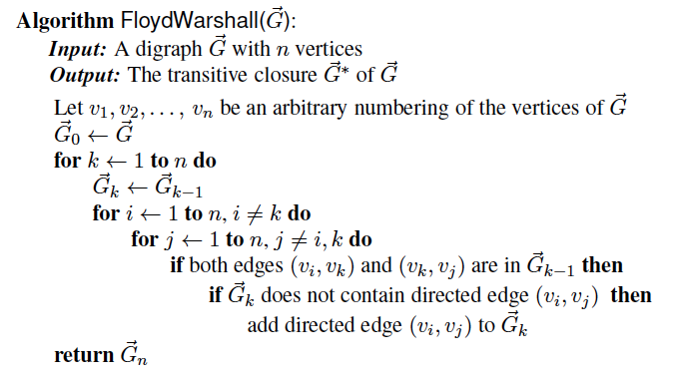
The Floyd-Warshall Algorithm
The running time is clearly O(n³).

Slide 58
Floyd-Warshall Example
BOS
ORD
v
4
JFK
v
2
v
6
SFO
DFW
LAX
v
v
3
1
MIA
v
5

Slide 59
Floyd-Warshall, Iteration 1
BOS
ORD
v
4
JFK
v
2
v
6
SFO
DFW
LAX
v
v
3
1
MIA
v
5

Slide 60
Floyd-Warshall, Iteration 2
BOS
ORD
v
4
JFK
v
2
v
6
SFO
DFW
LAX
v
v
3
1
MIA
v
5

Slide 61
Floyd-Warshall, Iteration 3
BOS
ORD
v
4
JFK
v
2
v
6
SFO
DFW
LAX
v
v
3
1
MIA
v
5

Slide 62
Floyd-Warshall, Iteration 4
BOS
ORD
v
4
JFK
v
2
v
6
SFO
DFW
LAX
v
v
3
1
MIA
v
5

Slide 63
Floyd-Warshall, Iteration 5
BOS
ORD
v
4
JFK
v
2
v
6
SFO
DFW
LAX
v
v
3
1
MIA
v
5

Slide 64
Floyd-Warshall, Iteration 6
BOS
ORD
v
4
JFK
v
2
v
6
SFO
DFW
LAX
v
v
3
1
MIA
v
5

Slide 65
Floyd-Warshall, Conclusion
BOS
ORD
v
4
JFK
v
2
v
6
SFO
DFW
LAX
v
v
3
1
MIA
v
5

Slide 66
DAGs and Topological Ordering
D
E
A directed acyclic graph (DAG) is a digraph that has no directed cycles
A topological ordering of a digraph is a numbering
v₁ , …, v_{n}
of the vertices such that for every edge (v_{i} , v_{j}), we have i < j
Example: in a task scheduling digraph, a topological ordering a task sequence that satisfies the precedence constraints
Theorem
A digraph admits a topological ordering if and only if it is a DAG
B
C
A
DAG G
v₄
v₅
D
E
v₂
B
v₃
v₁
C
Topological ordering of G
A

Slide 67
Topological Sorting
Number vertices, so that (u,v) in E implies u < v
wake up
1
A typical student day
2
3
eat
study computer sci.
4
5
nap
more c.s.
7
play
8
write c.s. program
6
9
work out
bake cookies
10
sleep
11
dream about graphs

Slide 68
Algorithm for Topological Sorting
Note: This algorithm is different than the one in the book (Algorithm 13.16).
Running time: O(n + m)
Algorithm TopologicalSort(G)
H ← G // Temporary copy of G
n ← G.numVertices()
while H is not empty do
Let v be a vertex with no outgoing edges
Label v ← n
n ← n − 1
Remove v from H

Slide 69
Implementation with DFS
Simulate the algorithm by using depth-first search
O(n+m) time.
Algorithm topologicalDFS(G, v)
Input graph G and a start vertex v of G
Output labeling of the vertices of G in the connected component of v
setLabel(v, VISITED)
for all e ∈ G.outEdges(v) { outgoing edges }
w ← opposite(v,e)
if getLabel(w) = UNEXPLORED
{ e is a discovery edge }
topologicalDFS(G, w)
else
{ e is a forward or cross edge }
Label v with topological number n
n ← n - 1
Algorithm topologicalDFS(G)
Input dag G
Output topological ordering of G n ← G.numVertices()
for all u ∈ G.vertices()
setLabel(u, UNEXPLORED)
for all v ∈ G.vertices()
if getLabel(v) = UNEXPLORED
topologicalDFS(G, v)

Slide 70
Topological Sorting Example

Slide 71
Topological Sorting Example
9

Slide 72
Topological Sorting Example
8
9

Slide 73
Topological Sorting Example
7
8
9

Slide 74
Topological Sorting Example
6
7
8
9

Slide 75
Topological Sorting Example
6
5
7
8
9

Slide 76
Topological Sorting Example
4
6
5
7
8
9

Slide 77
Topological Sorting Example
3
4
6
5
7
8
9

Slide 78
Topological Sorting Example
2
3
4
6
5
7
8
9

Slide 79
Topological Sorting Example
2
1
3
4
6
5
7
8
9

Slide 80
Biconnected Components
Presentation for use with the textbook, Algorithm Design and Applications, by M. T. Goodrich and R. Tamassia, Wiley, 2015
SEA
PVD
ORD
FCO
SNA
MIA

Slide 81
Application: Networking
A computer network can be modeled as a graph, where vertices are routers and edges are network connections between edges.
A router can be considered critical if it can disconnect the network for that router to fail.
It would be nice to identify which routers are critical.
We can do such an identification by solving the biconnected components problem.

Slide 82
Separation Edges and Vertices
Definitions
Let G be a connected graph
A separation edge of G is an edge whose removal disconnects G
A separation vertex of G is a vertex whose removal disconnects G
Applications
Separation edges and vertices represent single points of failure in a network and are critical to the operation of the network
Example
DFW, LGA and LAX are separation vertices
(DFW,LAX) is a separation edge
ORD
PVD
SFO
LGA
HNL
LAX
DFW
MIA

Slide 83
Biconnected Graph
Equivalent definitions of a biconnected graph G
Graph G has no separation edges and no separation vertices
For any two vertices u and v of G, there are two disjoint simple paths between u and v (i.e., two simple paths between u and v that share no other vertices or edges)
For any two vertices u and v of G, there is a simple cycle containing u and v
Example
PVD
ORD
SFO
LGA
HNL
LAX
DFW
MIA

Slide 84
Biconnected Components
Biconnected component of a graph G
A maximal biconnected subgraph of G, or
A subgraph consisting of a separation edge of G and its end vertices
Interaction of biconnected components
An edge belongs to exactly one biconnected component
A nonseparation vertex belongs to exactly one biconnected component
A separation vertex belongs to two or more biconnected components
Example of a graph with four biconnected components
ORD
PVD
SFO
LGA
RDU
HNL
LAX
DFW
MIA

Slide 85
Equivalence Classes
Given a set S, a relation R on S is a set of ordered pairs of elements of S, i.e., R is a subset of S×S
An equivalence relation R on S satisfies the following properties
Reflexive: (x,x) ∈ R
Symmetric: (x,y) ∈ R ⇒ (y,x) ∈ R
Transitive: (x,y) ∈ R ∧ (y,z) ∈ R ⇒ (x,z) ∈ R
An equivalence relation R on S induces a partition of the elements of S into equivalence classes
Example (connectivity relation among the vertices of a graph):
Let V be the set of vertices of a graph G
Define the relation C = {(v,w) ∈ V×V such that G has a path from v to w}
Relation C is an equivalence relation
The equivalence classes of relation C are the vertices in each connected component of graph G

Slide 86
Link Relation
Edges e and f of connected graph G are linked if
e = f, or
G has a simple cycle containing e and f
Theorem:
The link relation on the edges of a graph is an equivalence relation
Proof (see textbook):
The reflexive and symmetric properties follow from the definition
For the transitive, suppose f and g are linked and g and h are linked, show f and h are linked.
i
g
e
b
a
d
j
c
f
Equivalence classes of linked edges:
{a} {b, c, d, e, f} {g, i, j}
i
e
g
b
a
d
j
c
f

Slide 87
Link Components
The link components of a connected graph G are the equivalence classes of edges with respect to the link relation
A biconnected component of G is the subgraph of G induced by an equivalence class of linked edges
A separation edge is a single-element equivalence class of linked edges
A separation vertex has incident edges in at least two distinct equivalence classes of linked edge
ORD
PVD
SFO
LGA
RDU
HNL
LAX
DFW
MIA

Slide 88
Auxiliary Graph to find Linked Components
g
h
Auxiliary graph B for a connected graph G
Associated with a DFS traversal of G
The vertices of B are the edges of G
For each back edge e of G, B has edges (e,f₁), (e,f₂) , …, (e,f_{k}), where f₁, f₂, …, f_{k} are the discovery edges of G that form a simple cycle with e
Its connected components correspond to the link components of G
e
i
b
j
i
c
d
f
a
DFS on graph G
g
e
i
h
b
f
j
d
c
a
Auxiliary graph B

Slide 89
Auxiliary Graph Example
In the worst case, the number of edges of the auxiliary graph is proportional to nm
DFS on graph G
Auxiliary graph B

Slide 90
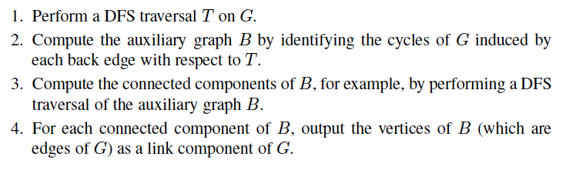
An O(nm)-Time Algorithm
Lemma: The connected components of the auxiliary graph B correspond to the link components of the graph G that induced B.
This lemma yields the following O(nm)-time algorithm for computing all the link components of a graph G with n vertices and m edges:

Slide 91
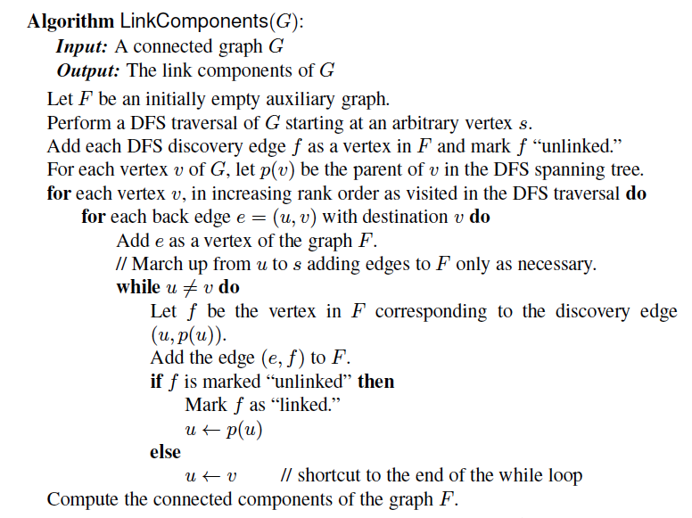
A Linear-Time O(m) Algorithm

Slide 92
Analysis with Auxiliary Graph, F
g
h
Auxiliary graph F for a connected graph G
Spanning forest of the auxiliary graph F
Has m vertices and O(m) edges
Can be constructed in O(n + m) time
Its connected components (trees) correspond to the the link components of G
Theorem: Given a graph G, we can compute the following in
O(n + m) time:
The biconnected components of G
The separation vertices of G
The separation edges of G
i
b
e
j
i
c
d
f
a
DFS on graph G
g
e
i
h
b
f
j
d
c
a
Proxy graph F

